Slide 1
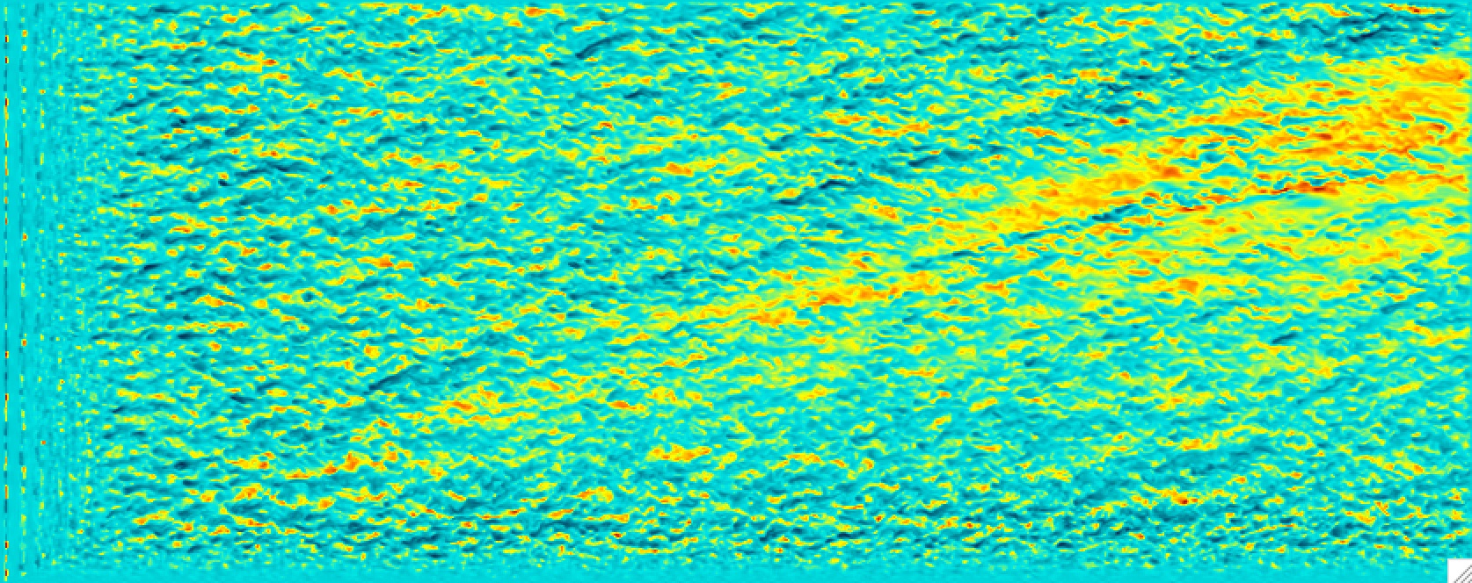
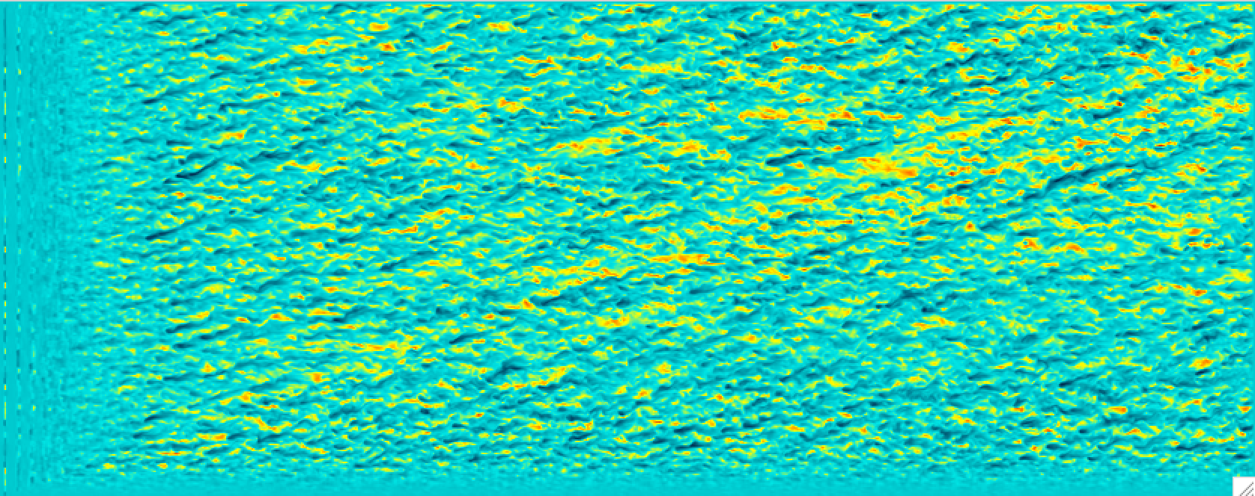
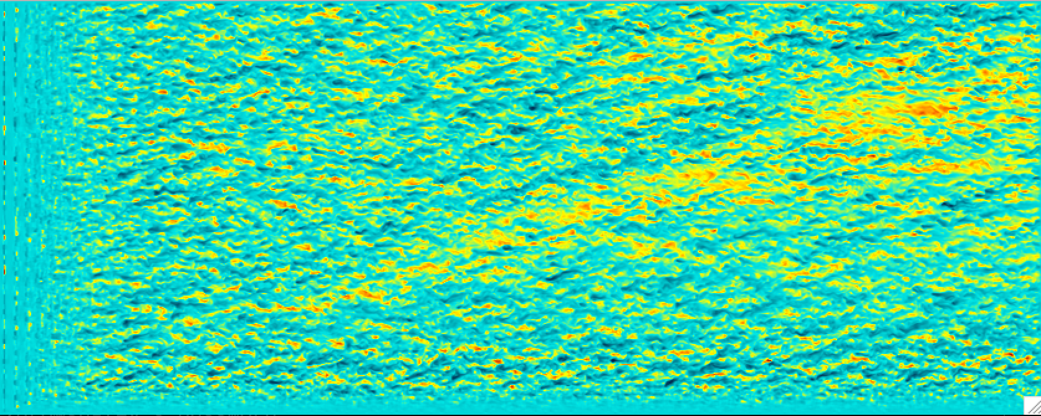
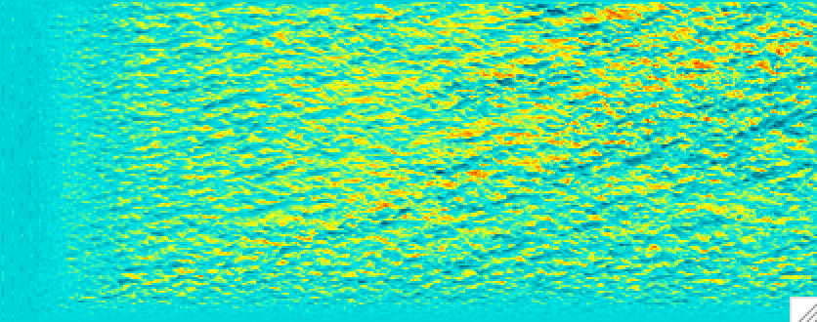
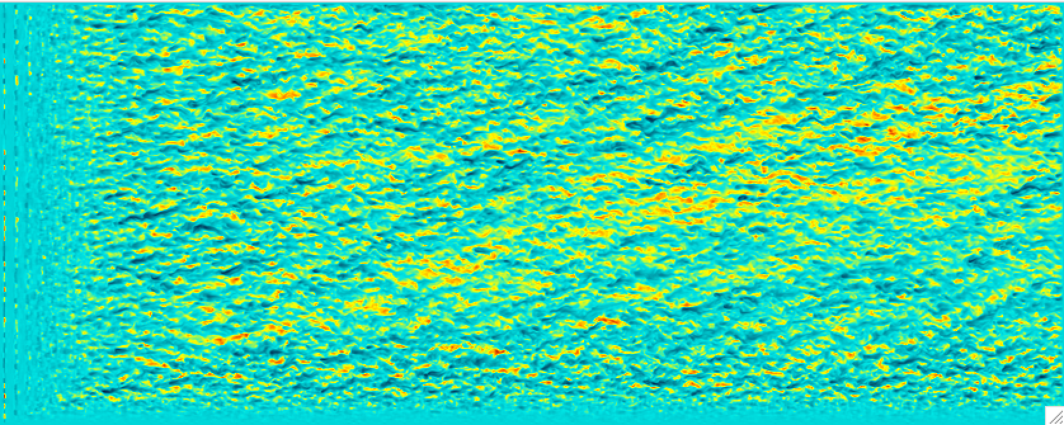
Z = 240 m
9-1-0: 0.5
9-1-1: 0.25
9-1-5: 0.40
9-1-3: 0.125
9-1-4: 0.35

Slide 2
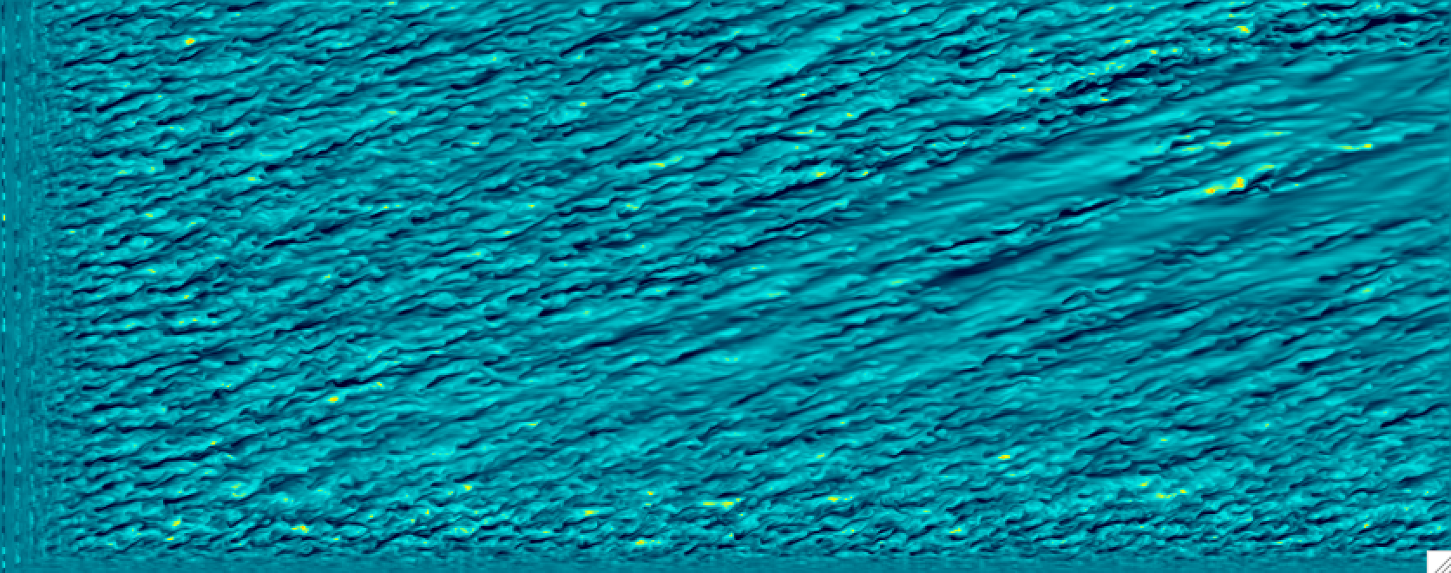

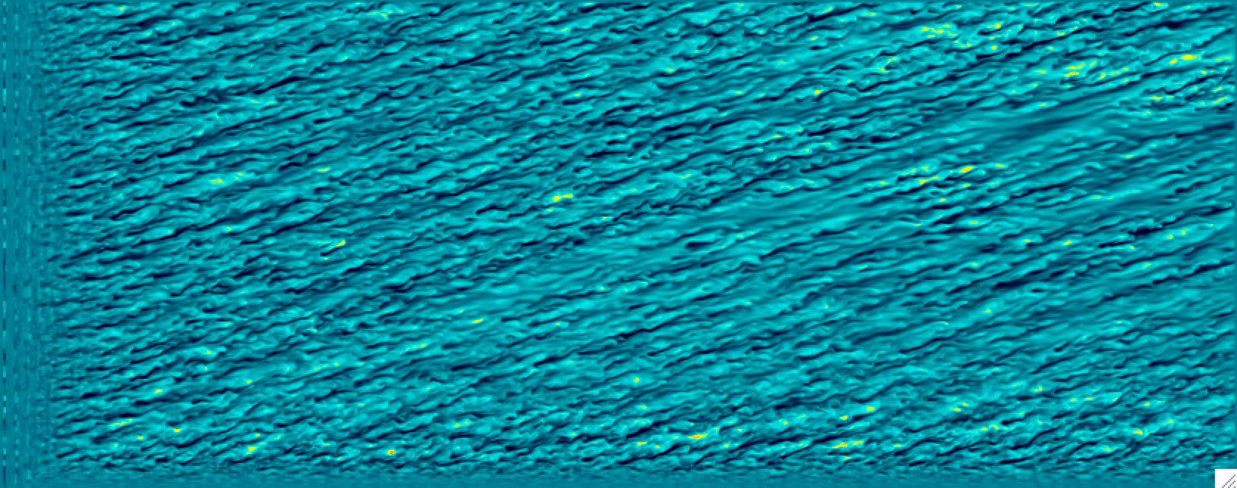


Z = 100 m
9-1-0: 0.5
9-1-1: 0.25
9-1-5: 0.40
9-1-3: 0.125
9-1-4: 0.35

Slide 3
9-1-0: 0.5
9-1-5: 0.40
9-1-4: 0.35
9-1-1: 0.25
9-1-3: 0.125

Slide 4
0.5K – z = 100m
0.25K – z = 100m
0.35K – z = 240m
0.5K – z = 240m

Slide 5
0.5K – z = 100m
0.35K – z = 100m
0.25K – z = 240m
0.5K – z = 240m

